Slide 1

Personalized Education: Paths to Success
Matthew Mitchell

Slide 2

Meeting Diverse Needs
How can we best serve individual student needs?
How can we measure student success?

Slide 3


One size does not fit all
Jordan
Alex

Slide 4
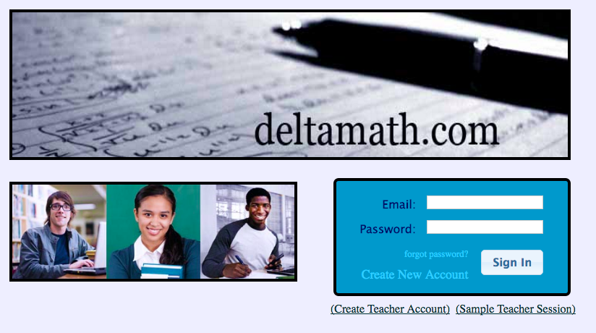
Data
6 months of data
10 million problems answered
55,000 students
800 Question Types
5 Subjects: Pre-Algebra, Algebra, Geometry, Algebra 2/Trig, and Calculus

Slide 5
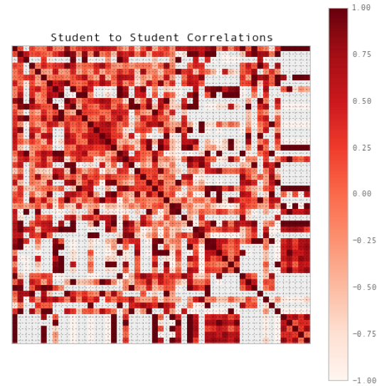
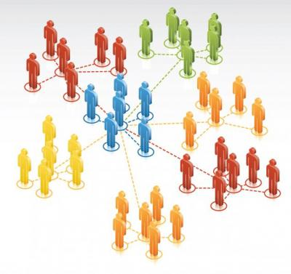
Selecting Appropriate Groups
A
l
ex
Jordan

Slide 6

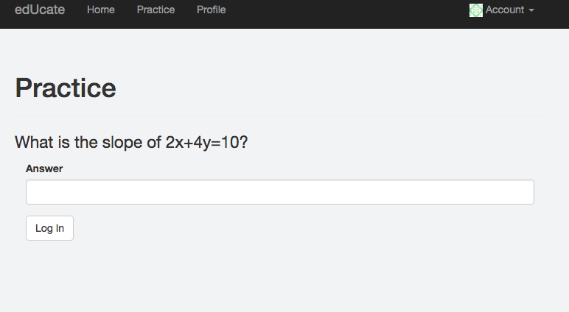
Personalized Learning:
Initial
Problem
Set
Unique
Learning
Paths
Continual
Reassessment =
Dynamic Instruction

Slide 7
edUcate
Flask Web Development
Deployed via Heroku

Slide 8
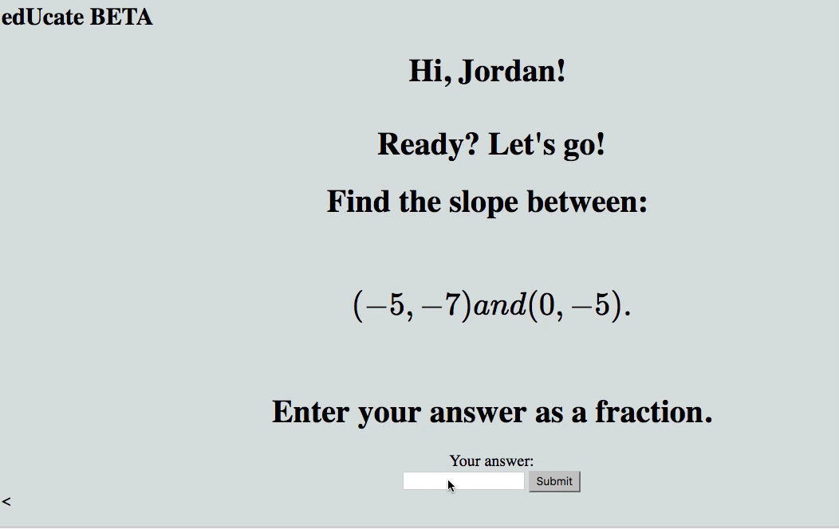
Adapting to their needs

Slide 9
Try edUcate!
Customized Problem Sets
Student Intervention Groups
Curriculum assessment

Slide 10


Thanks!
Matthew Mitchell matthew-mitchell.github.io github.com/matthew-mitchell

